Slide 1
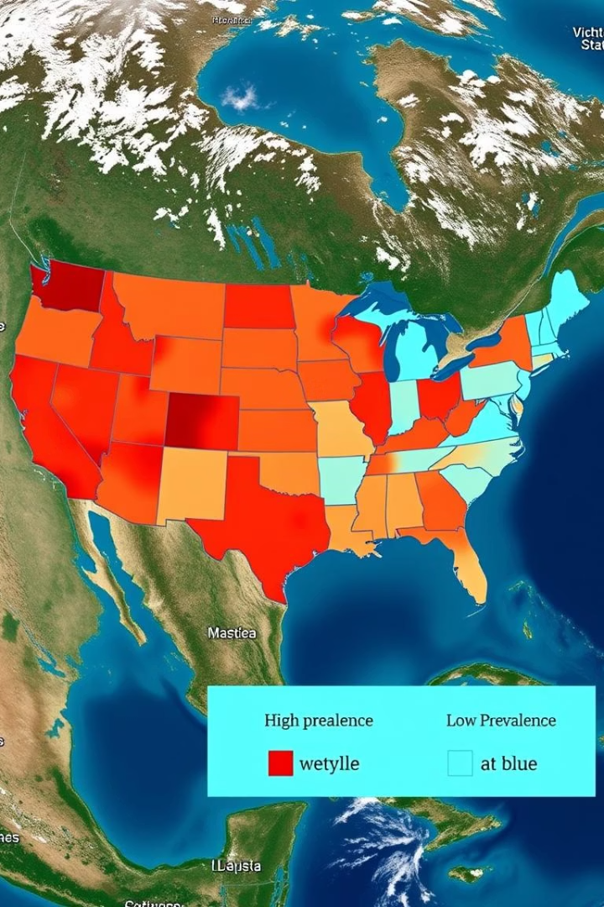

Spatial Epidemiology of Influenza in the U.S.
This presentation explores the spatial epidemiology of influenza in the United States. By integrating surveillance data, socio-demographics, and hotspot analysis using GIS, we aim to understand the geographical patterns and risk factors associated with flu transmission. This research will highlight areas of concern and potential interventions to mitigate the impact of influenza on public health. Presented by Frank Ofosu & Nandhika Rajmanikandan.
by Nandhika Rajmanikandan &
Frank Ofosu

Slide 2
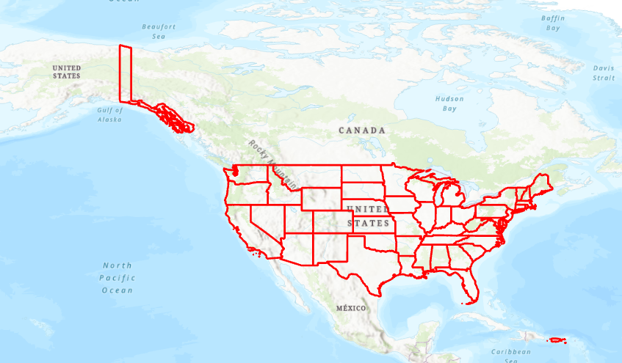
Introduction
Influenza remains a significant public health concern, exhibiting notable regional variability across the United States. Understanding the spatial dynamics of influenza transmission is crucial for effective public health interventions. This study explores the spatial patterns and identifies potential risk factors associated with flu transmission across various U.S. states, employing ArcGIS Pro 3, Python, and Google Sheets for comprehensive analysis.
Influenza Variability
Study Objectives
Explore spatial patterns and risk factors of flu transmission.
Regional differences in flu prevalence require focused analysis.
Analytical Tools
Utilizing ArcGIS Pro 3, Python, and Google Sheets.

Slide 3





Data Sources
To conduct a comprehensive spatial epidemiological analysis of influenza, various data sources were integrated. Boundary data was sourced from U.S. Census shapefiles to define geographical boundaries. Flu surveillance data was obtained from the CDC FluView, including ILINet (Influenza-like Illness Network) and Clinical Labs data. Additionally, demographic data on multigenerational households was acquired from the American Community Survey (ACS 2019) to explore potential socio-demographic risk factors.
Boundary Data
Flu Surveillance
Demographic Data

Slide 4
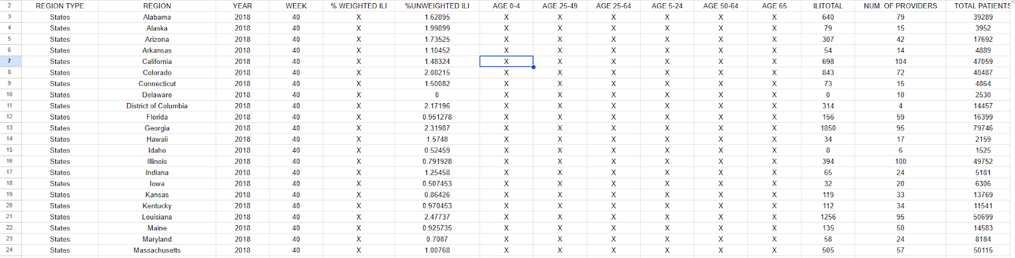
Data Cleaning & Preprocessing
Effective data cleaning and preprocessing were essential to ensure data quality and consistency for subsequent analysis. Irrelevant or missing columns, such as Region Type and non-numeric placeholders, were removed to streamline the datasets. The 'Season\_Week' variable was feature engineered to establish temporal consistency. Missing data, indicated by 'X' values in the lab results, were carefully cleaned to avoid skewing the analysis.
Remove Irrelevant Columns
Clean Missing Data
1
2
3
Feature Engineering

Slide 5
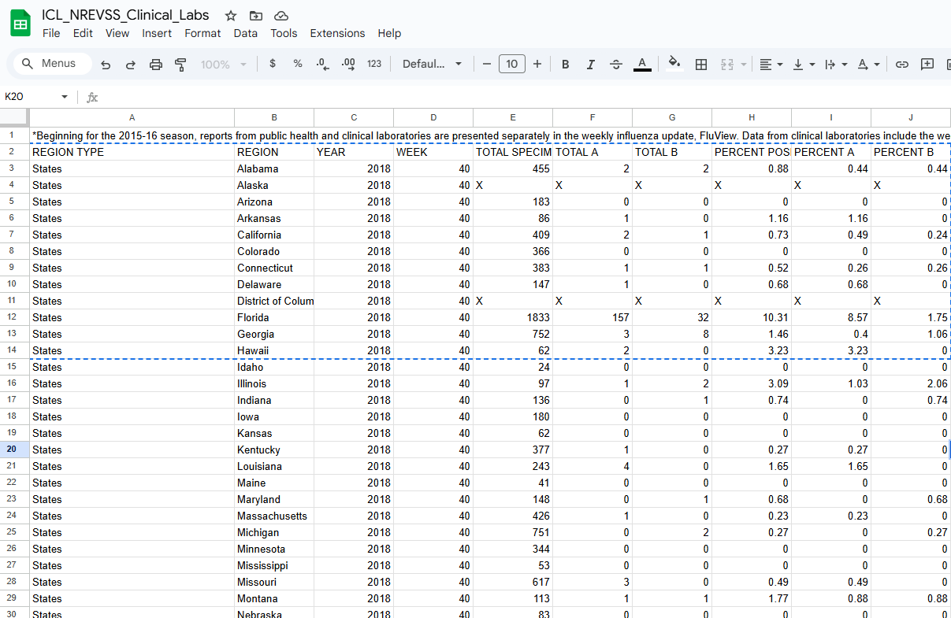
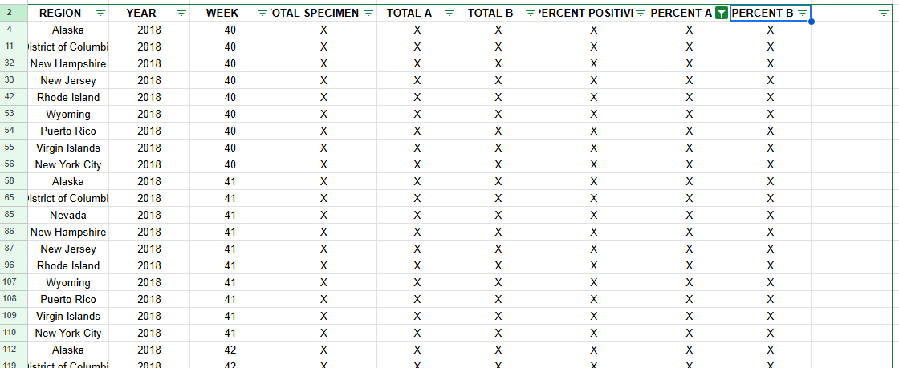
Dataset Overview
The ILINet dataset comprised 2,809 observations with 7 variables, while the Clinical Labs dataset included 2,278 observations with 9 variables after cleaning. Key variables in the ILINet dataset involved ILI (Influenza-like Illness) counts, providing insights into the spread of influenza-like illnesses. The Clinical Labs dataset included lab results (Type A/B) and positivity rates, offering information on confirmed influenza cases and prevalence.
2809
ILINet Observations
2278
Clinical Labs Observations
7
ILINet Variables
9
Clinical Labs Variables

Slide 6
Exploratory Data Analysis
Exploratory Data Analysis (EDA) revealed a strong positive correlation between ILITotal (total influenza-like illness cases) and Total Patients, indicating that higher patient counts are associated with increased ILI cases. Conversely, a weak or no correlation was found between the percentage of multigenerational households and the percentage of positive flu cases, suggesting that household structure may not be a primary driver of flu transmission. Distribution plots indicated skewed population metrics, influencing data interpretation.
Strong Correlation
1
ILITotal vs. Total Patients.
Weak Correlation
2
Multigenerational % vs. % Positive.
Skewed Metrics
3
Distribution plots.

Slide 7
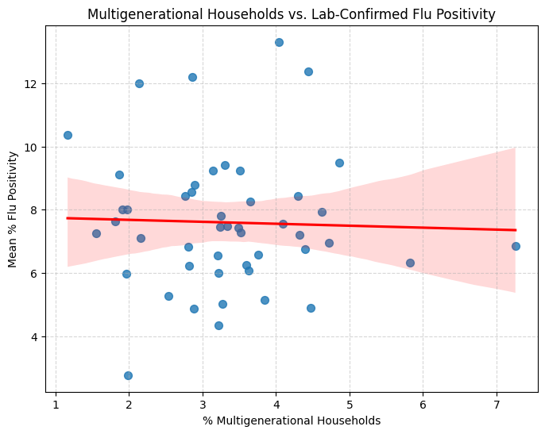
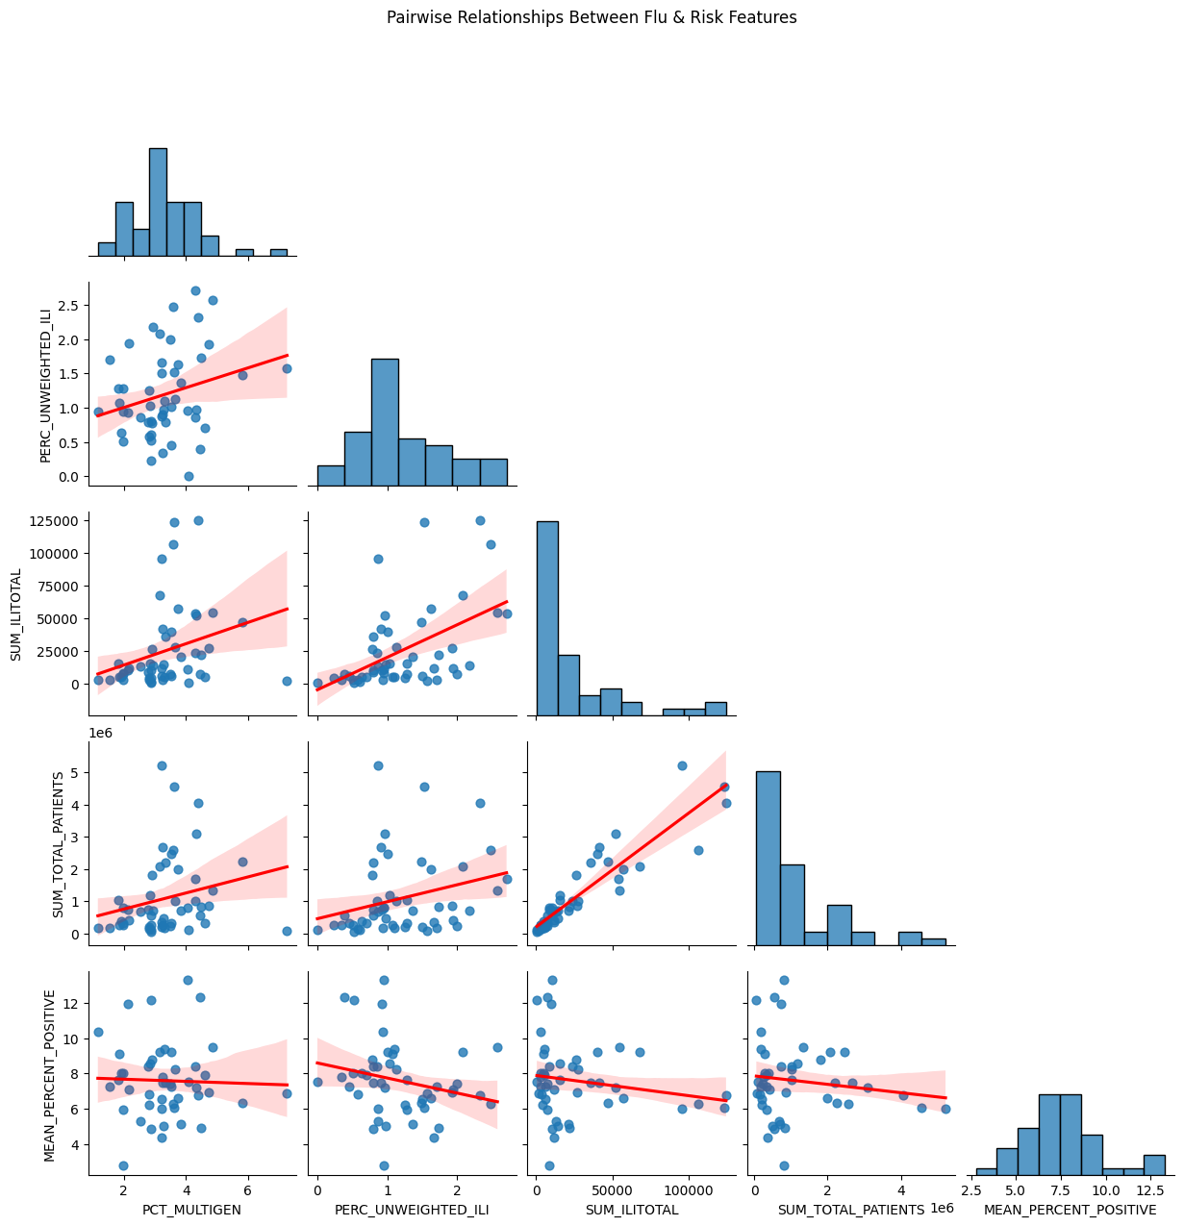
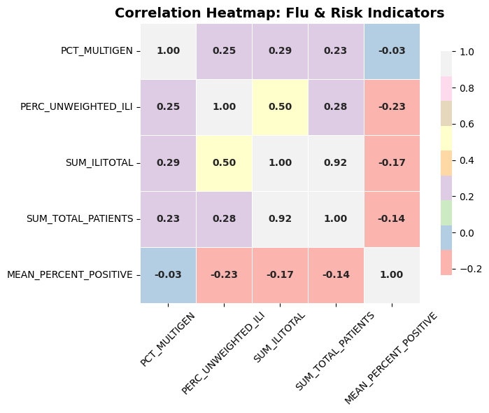

Slide 8
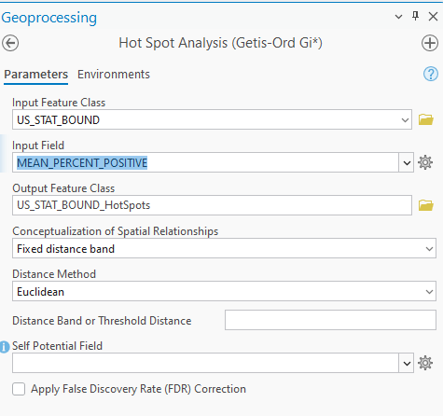




Geospatial Processing
To enable spatial analysis, shapefiles were projected to WGS 84 to ensure accurate geographical representation. Cleaned CSVs were imported into a geodatabase to facilitate spatial operations. Joins were performed to manage one-to-many relationships using region and state names, linking surveillance data with geographical boundaries. Metrics were aggregated to create summaries of flu seasons, providing a basis for spatial comparisons and pattern identification.
Project Shapefiles
Import CSVs
Perform Joins
Aggregate Metrics

Slide 9
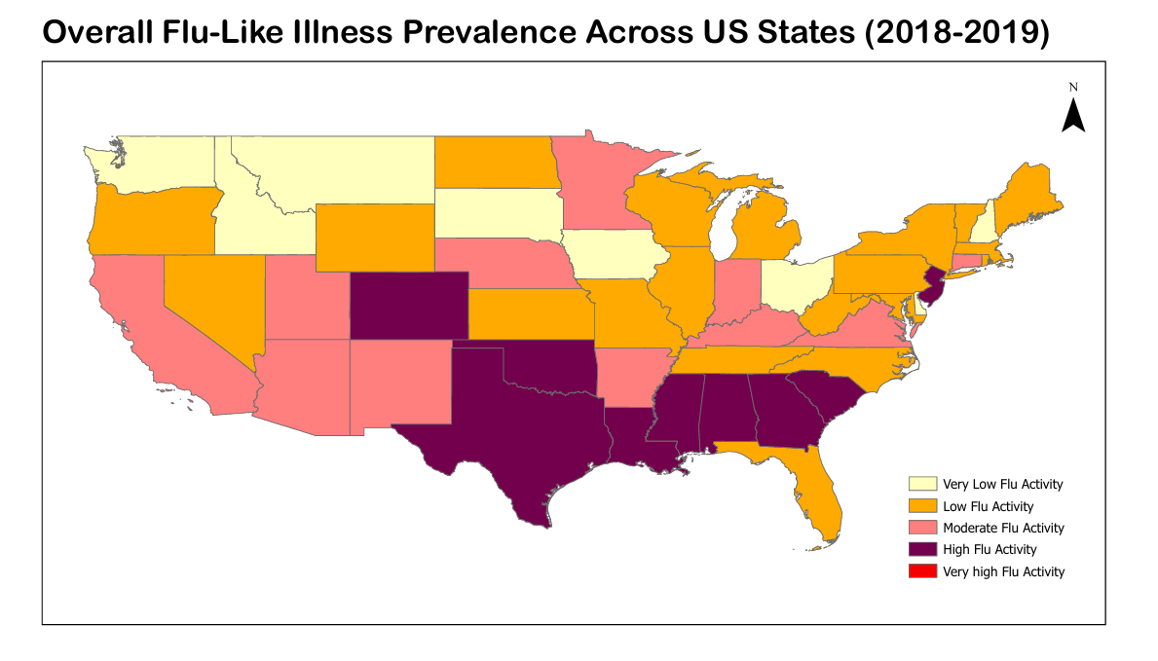
Mapping & Visualization

Slide 10
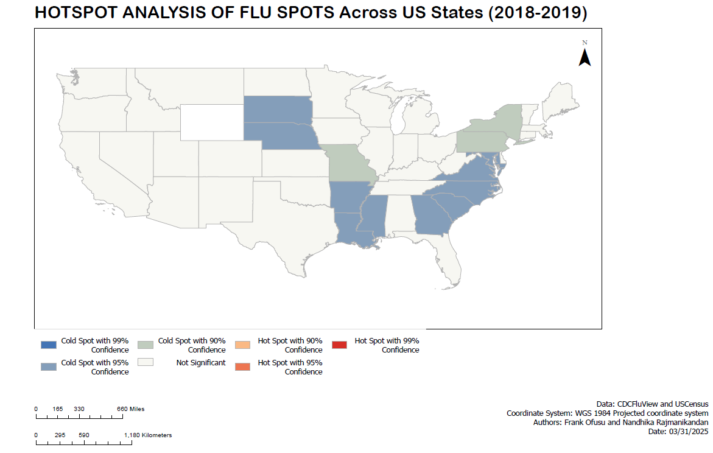
Hotspot Analysis
The Getis-Ord Gi* statistic was employed to identify statistically significant flu hotspots, revealing non-random clustering of flu cases. Hotspots, indicating areas with significantly higher flu incidence, were identified in GA, SC, AL, and MS with a 95% confidence level. Conversely, cold spots, representing areas with significantly lower flu incidence, were observed in ND, NE, and MT. These findings suggest spatial autocorrelation in flu transmission patterns.
Hotspots: GA, SC, AL, MS
Coldspots: ND, NE, MT

Slide 11
Multigenerational Households
Data from the ACS 2019 on the percentage of households with three or more generations was joined and mapped with flu data to explore the potential role of multigenerational households as a transmission risk factor. As an example, California had 5.8% multigenerational households. However, exploratory analysis revealed a weak or no correlation between the percentage of multigenerational households and the percentage of positive flu cases, suggesting that other factors may play a more significant role in transmission.
ACS 2019 Data
Mapping with Flu Data
Weak Correlation
Percentage of households with 3+ generations.
Multigenerational % vs. % Positive.
Exploring transmission risk factors.

Slide 12
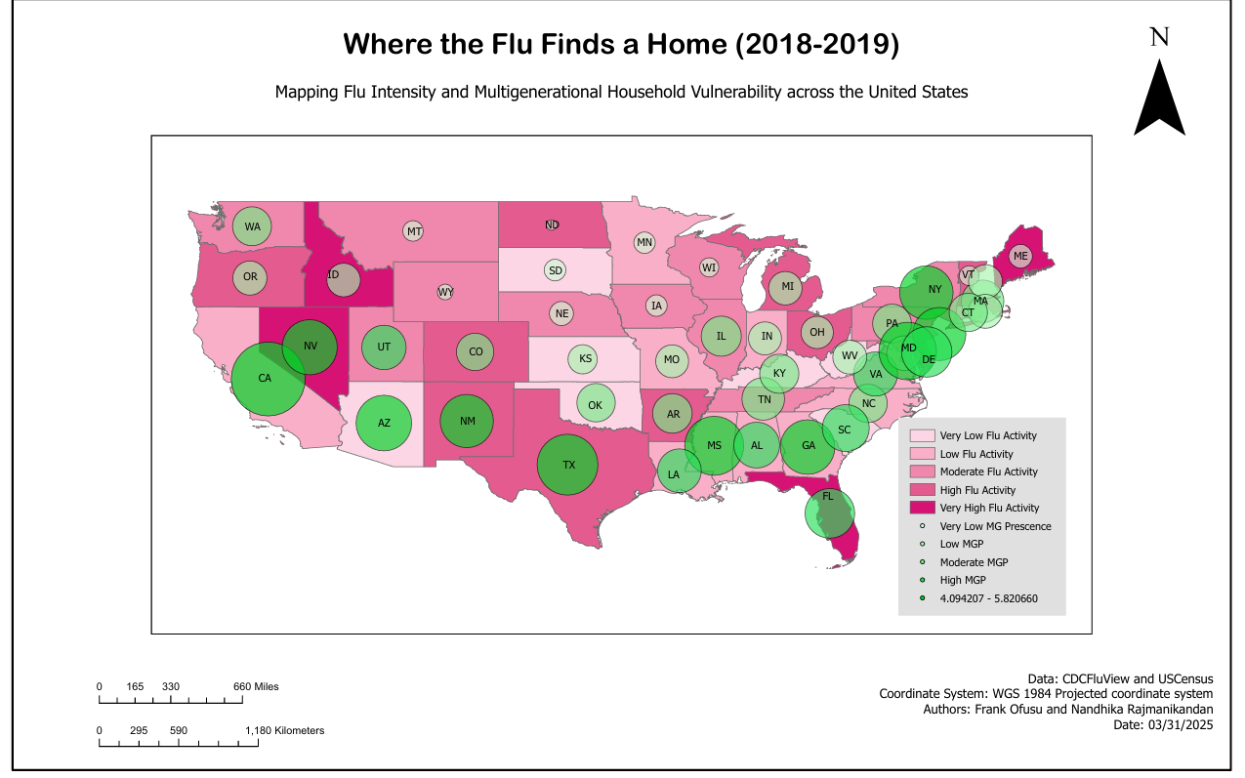

Slide 13
References
U.S. Census Bureau. (2018). Cartographic Boundary Shapefiles – States [Shapefile]. U.S. Census Bureau Geography Division. https://www.census.gov/geographies/mapping-files/time-series/geo/carto-boundary-file.html
Centers for Disease Control and Prevention. (2019). FluView Interactive: Influenza Surveillance Data [Dashboard]. U.S. Influenza Surveillance System. https://gis.cdc.gov/grasp/fluview/fluportaldashboard.html
U.S. Census Bureau. (2019). B11017: Multigenerational households [Data set]. American Community Survey 1-Year Estimates. https://data.census.gov/table/ACSDT1Y2019.B11017
Lofgren, E., Fefferman, N. H., Naumov, Y. N., Gorski, J., & Naumova, E. N. (2007). Influenza seasonality: underlying causes and modeling theories. Journal of Virology, 81(11), 5429–5436. https://doi.org/10.1128/JVI.01691-06
Charu, V., Zeger, S., Gog, J., Bjørnstad, O. N., Kissler, S., Simonsen, L., & Viboud, C. (2017). Human mobility and the spatial transmission of influenza in the United States. PLoS Computational Biology, 13(2), e1005382. https://doi.org/10.1371/journal.pcbi.1005382
Liu, T., He, G., Zhang, Y., Jiang, J., Wu, M., & Xu, F. (2020). Spatiotemporal trends and socio-demographic factors associated with influenza-like illness in China: A case study of Suzhou City, 2009–2018. International Journal of Environmental Research and Public Health, 17(3), 729. https://doi.org/10.3390/ijerph17030729
Getis, A., & Ord, J. K. (1992). The analysis of spatial association by use of distance statistics. Geographical Analysis, 24(3), 189–206. https://doi.org/10.1111/j.1538-4632.1992.tb00261.x

